Slide 1
OPS 803 GROUP PROJECT
Colin Suarez Yiwen Zhu

Slide 2
ABOUT
Social Media Database system in MYSQL Business Functions: Marketing Product

Slide 3
DESIGN

Slide 4
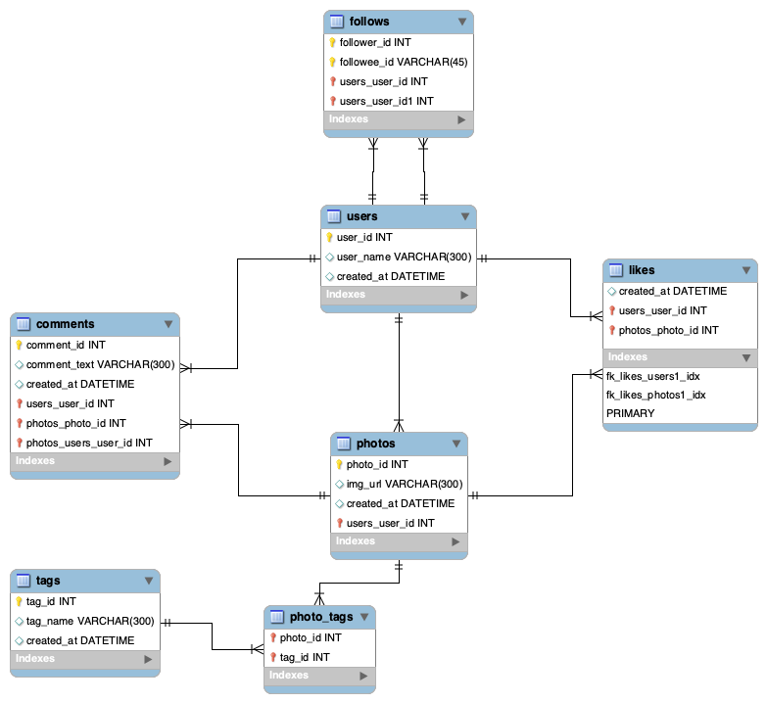
ERR DIAGRAM

Slide 5
Tables & RELATIONSHIPS

Slide 6
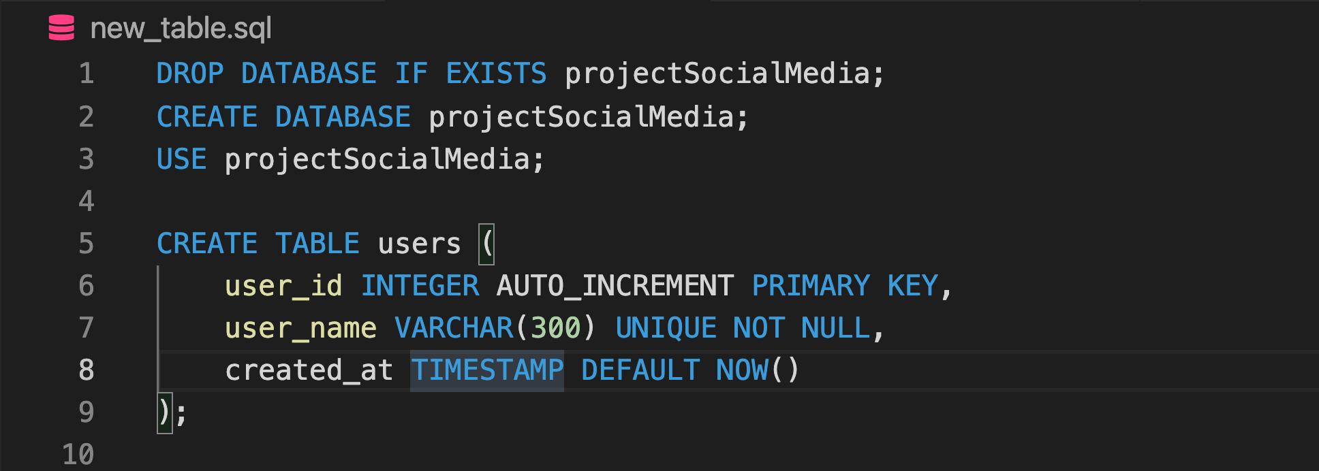

Slide 8
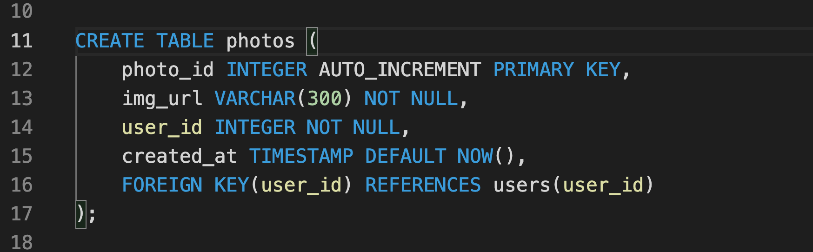

Slide 10
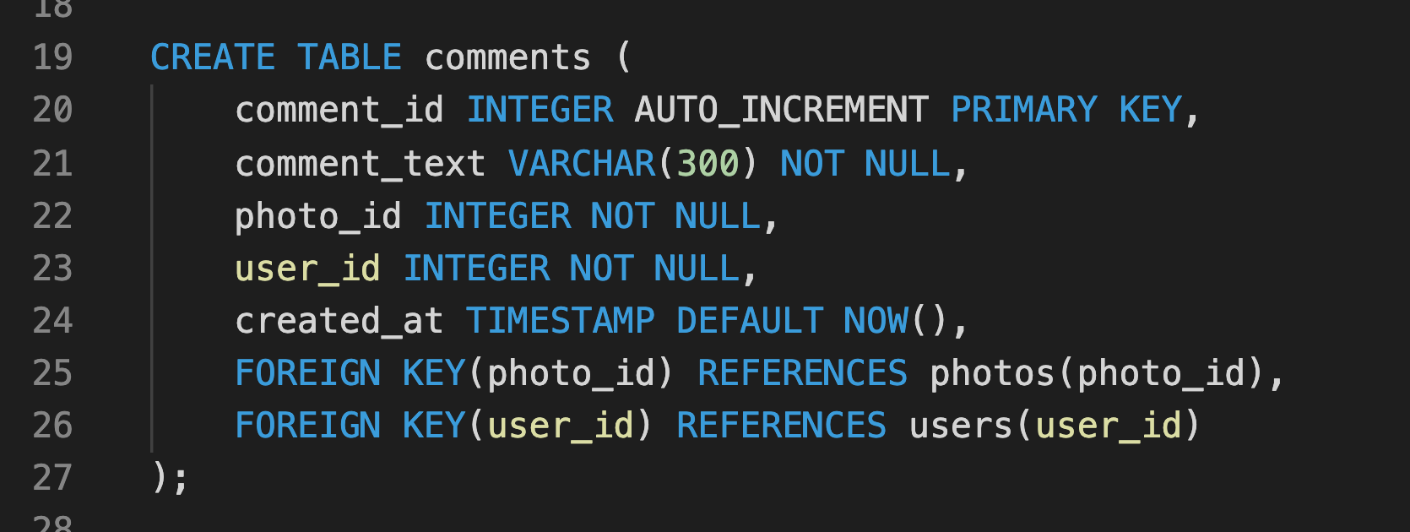

Slide 12
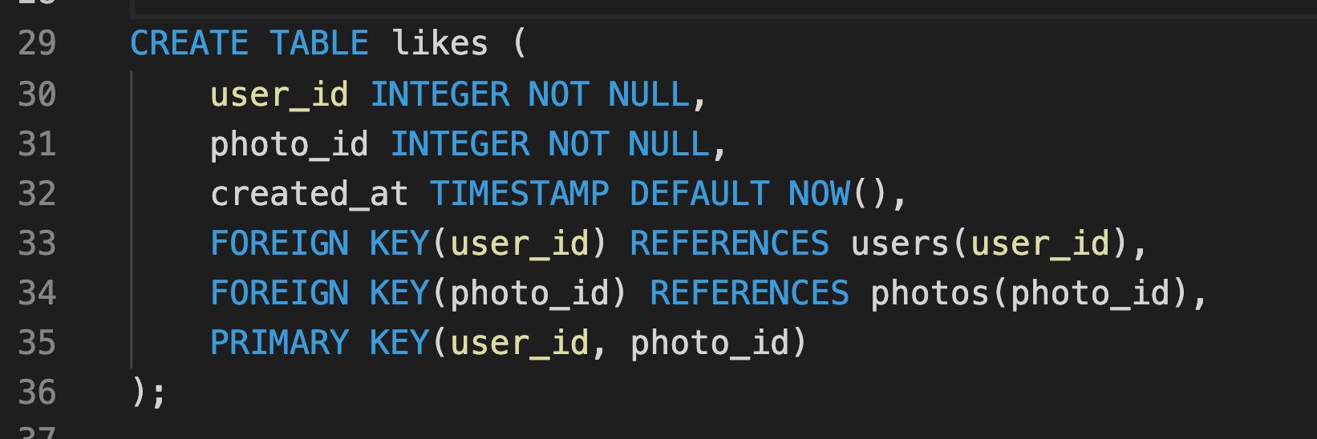

Slide 14
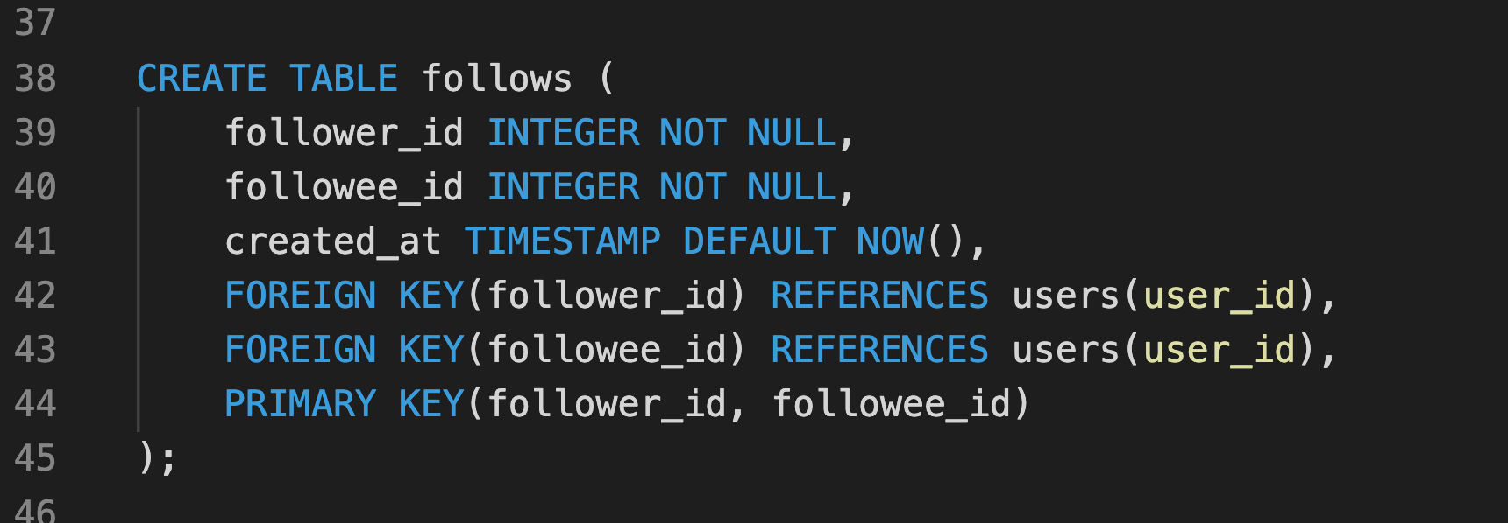

Slide 16
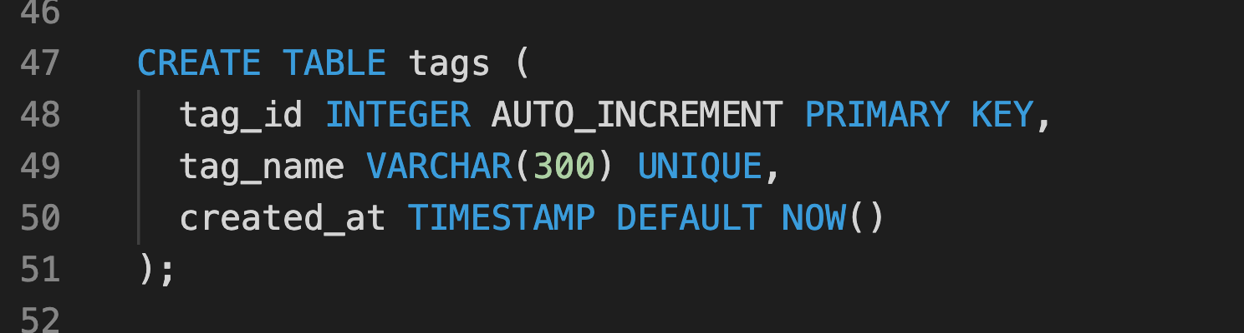

Slide 18
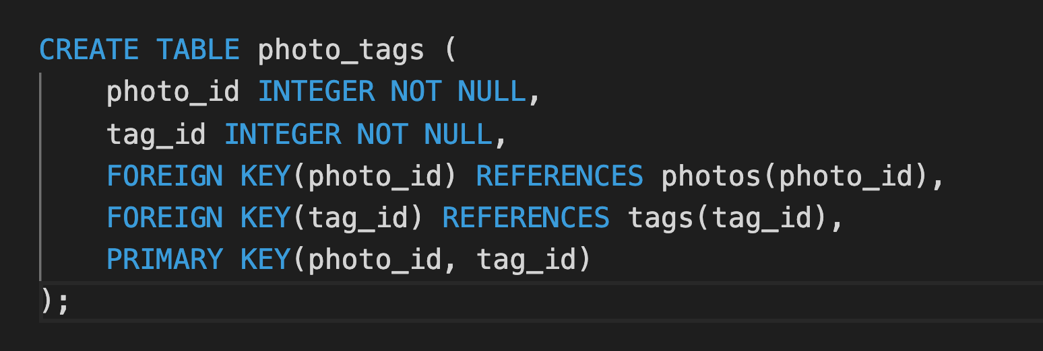

Slide 19
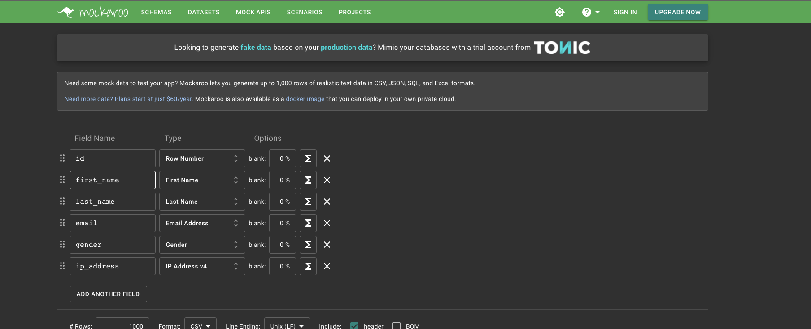
DATA SOURCE
https://www.mockaroo.com/
To generate fake data for all of our tables

Slide 20
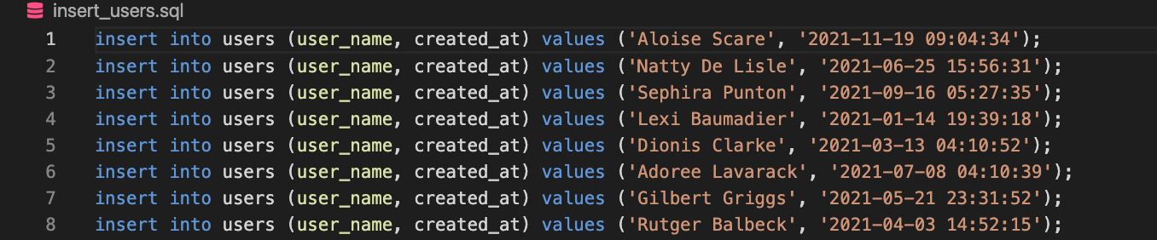
Insert Users

Slide 21
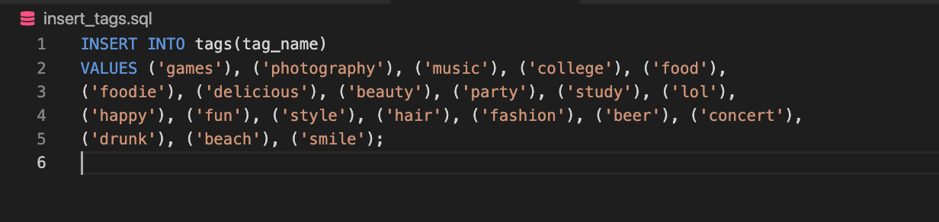
Insert Tags

Slide 22
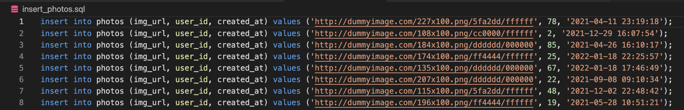
Insert Photos

Slide 23
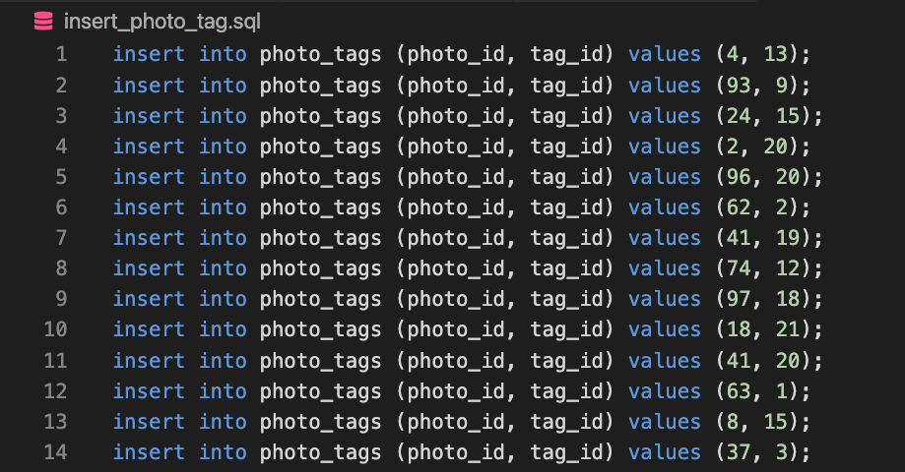
Insert Photo_tags

Slide 24
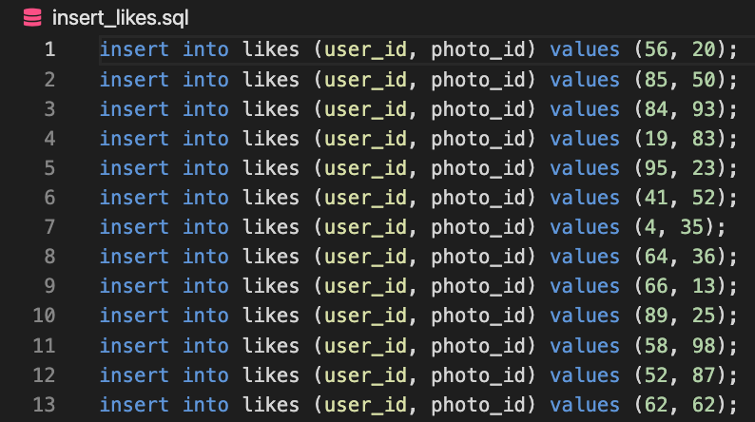
Insert Likes

Slide 25
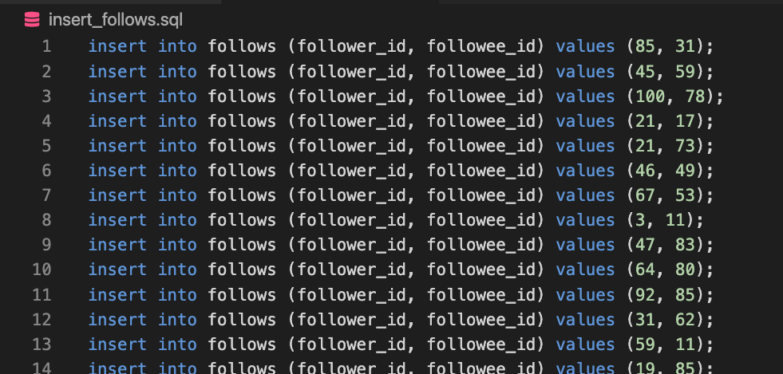
Insert follows

Slide 26
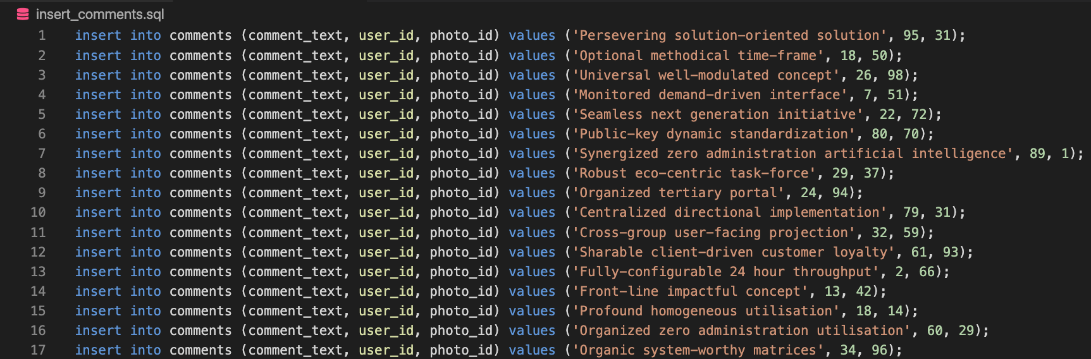
Insert Comments

Slide 27
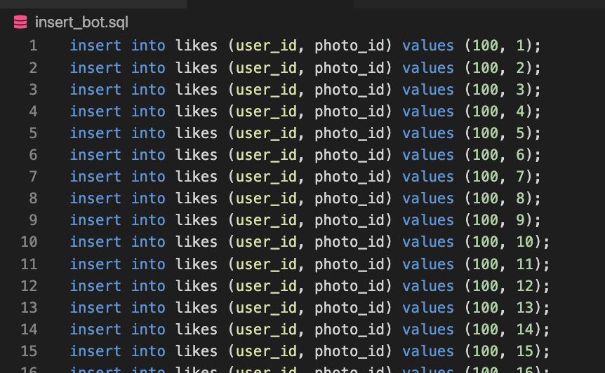
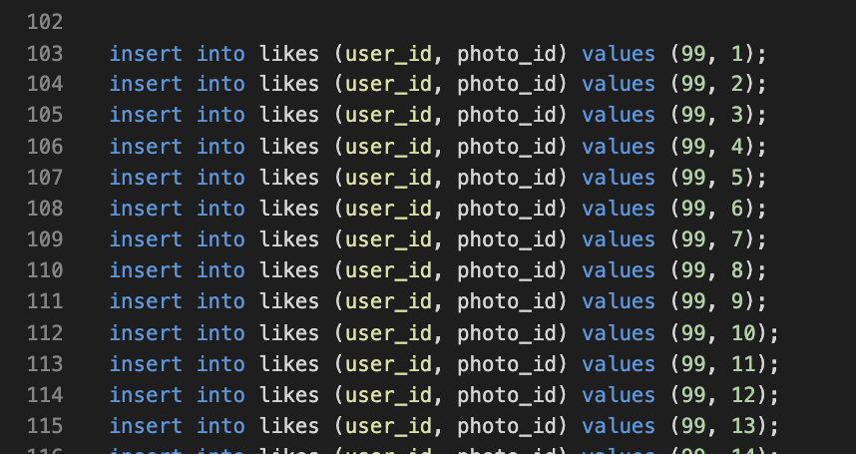
Add Bots for Business case

Slide 28
Business Insights & Decisions

Slide 29
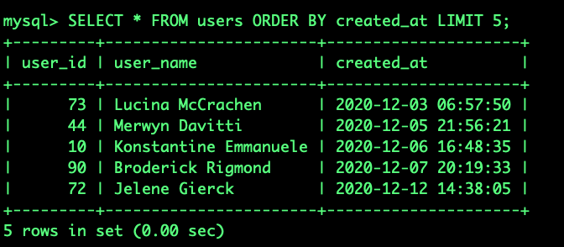
Consumer Loyalty
Find 5 users who have been around the longest
SELECT * FROM users ORDER BY created_at LIMIT 5;

Slide 30
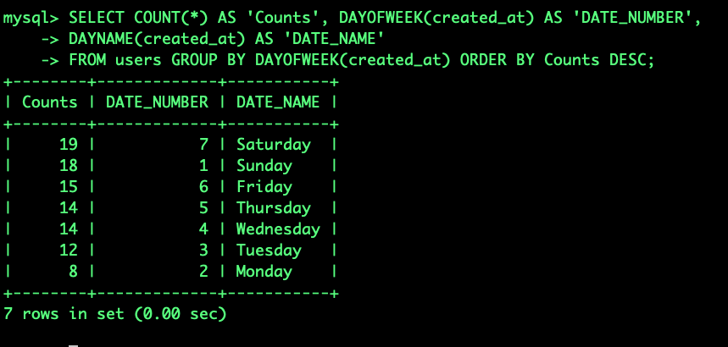
Targeting Campaigns
What day of the week do most users register on? We need to figure out when to schedule an ad campaign
SELECT COUNT(*) AS 'Counts', DAYOFWEEK(created_at) AS 'DATE_NUMBER',
DAYNAME(created_at) AS 'DATE_NAME'
FROM users GROUP BY DAYOFWEEK(created_at) ORDER BY Counts DESC;

Slide 31
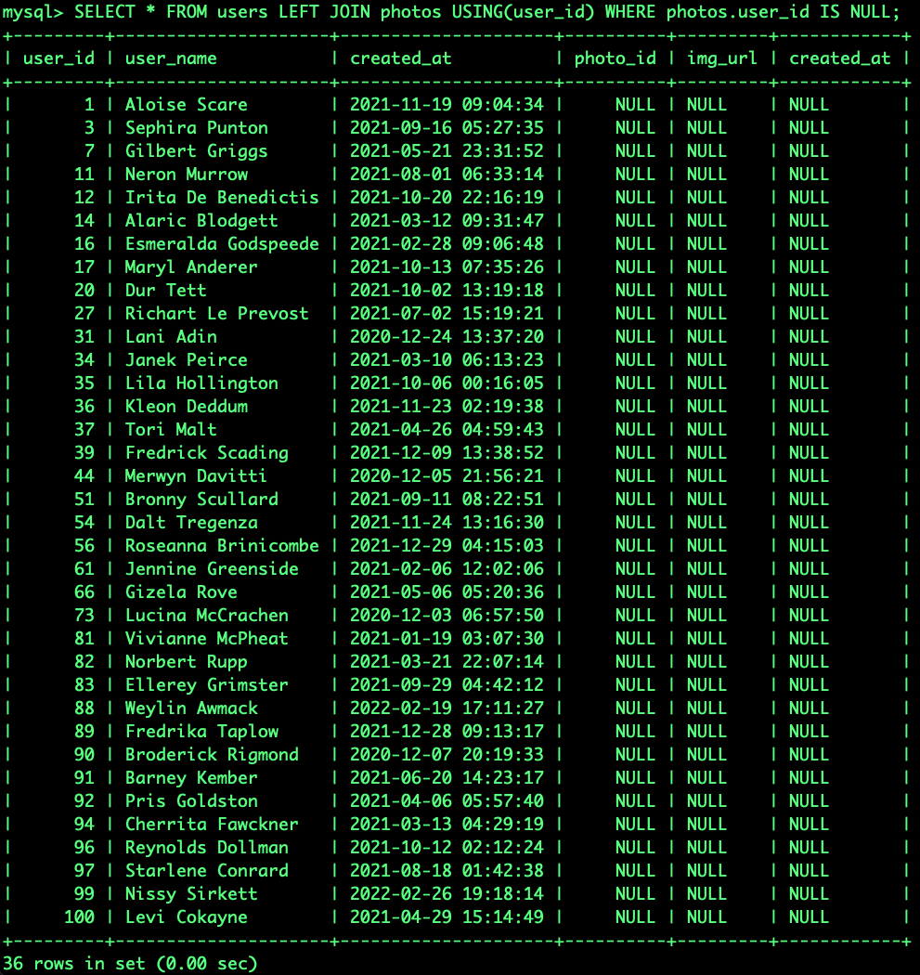
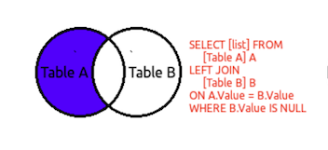
Customer Engagement
We want to target our inactive users with an email campaign. Find the users who have never posted a photo
SELECT * FROM users LEFT JOIN photos USING(user_id) WHERE photos.user_id IS NULL;

Slide 32
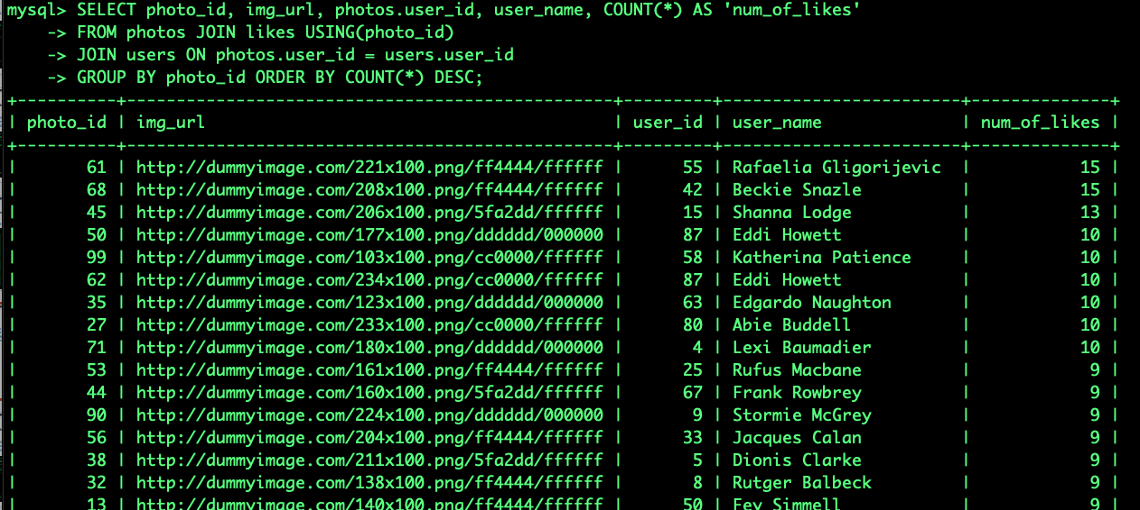
Popular Product
Find most like photo and user who create it
SELECT photo_id, img_url, photos.user_id, user_name, COUNT(*) AS 'num_of_likes'
FROM photos JOIN likes USING(photo_id)
JOIN users ON photos.user_id = users.user_id
GROUP BY photo_id ORDER BY COUNT(*) DESC [LIMIT 5];

Slide 33
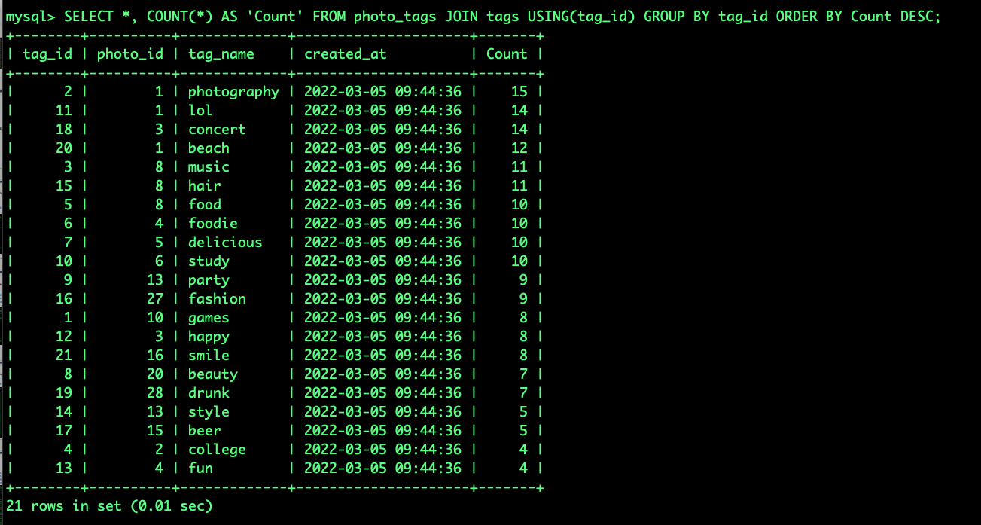
Popular Category
What are the top most commonly used hashtags?
SELECT *, COUNT(*) AS 'Count' FROM photo_tags JOIN tags USING(tag_id) GROUP BY tag_id ORDER BY Count DESC;

Slide 34
Resource allocation
WHAT part of day are most posts are being made
WITH hours AS (SELECT EXTRACT(Hour FROM created_at) AS hourofday, count(*) numofposts
FROM photos
GROUP BY hourofday)
SELECT sum(numofposts) AS TotalPosts,
CASE
WHEN hourofday >= 0 and hourofday < 6 THEN 'Dawn'
WHEN hourofday >= 6 and hourofday < 12 THEN 'Morning'
WHEN hourofday >= 12 and hourofday < 18 THEN 'Afternoon'
ELSE 'Evening'
END AS PartOfDay
FROM hours
GROUP BY PartOfDay
ORDER BY TotalPosts DESC;

Slide 35
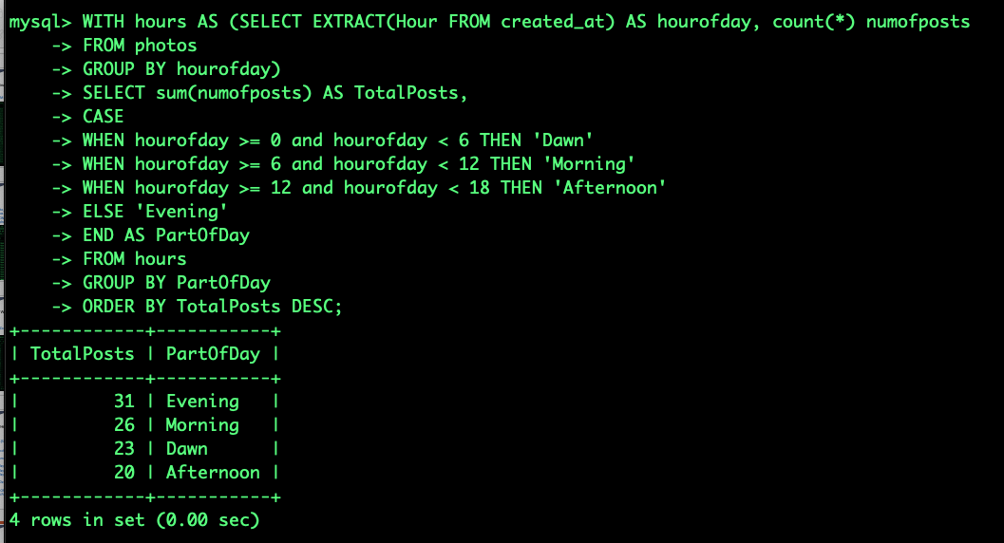

Slide 36
Resource allocation con
WHAT part of day are most accounts being made
WITH hours AS (SELECT EXTRACT(Hour FROM created_at) AS hourofday, count(*) numofaccts
FROM users
GROUP BY hourofday)
SELECT sum(numofaccts) AS TotalAccts,
CASE
WHEN hourofday >= 0 and hourofday < 6 THEN 'Dawn'
WHEN hourofday >= 6 and hourofday < 12 THEN 'Morning'
WHEN hourofday >= 12 and hourofday < 18 THEN 'Afternoon'
else 'Evening'
END AS PartOfDay
FROM hours
GROUP BY PartOfDay
ORDER BY TotalAccts DESC;

Slide 37
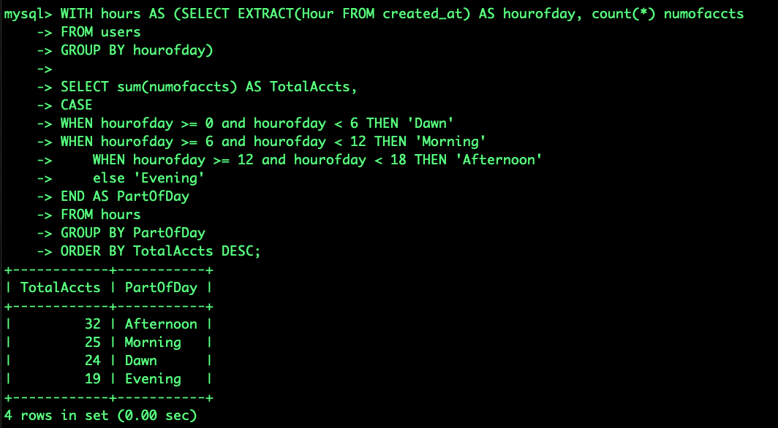

Slide 38
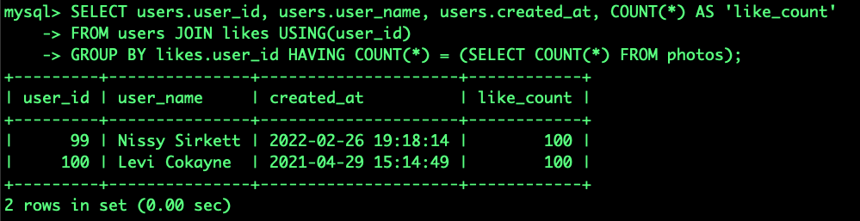
Filtering Bots
Find potential bots, users who have liked every single photo on the site
SELECT users.user_id, users.user_name, users.created_at, COUNT(*) AS 'like_count'
FROM users JOIN likes USING(user_id)
GROUP BY likes.user_id HAVING COUNT(*) = (SELECT COUNT(*) FROM photos);

Slide 39
Trigger Table for monitoring Bots
CREATE TABLE bots (
user_id INTEGER AUTO_INCREMENT PRIMARY KEY,
created_at TIMESTAMP DEFAULT NOW()
);
DELIMITER //
CREATE TRIGGER capture_bot
AFTER INSERT ON likes FOR EACH ROW
BEGIN
IF NEW.user_id IN (SELECT users.user_id, users.user_name, users.created_at, COUNT(*) AS ‘like_count'
FROM users JOIN likes USING(user_id)
GROUP BY likes.user_id HAVING COUNT(*) = (SELECT COUNT(*) FROM photos)
)
THEN
INSERT INTO bots(user_id) VALUES (NEW.user_id);
END IF;
END;
// DELIMITER ;

Slide 40
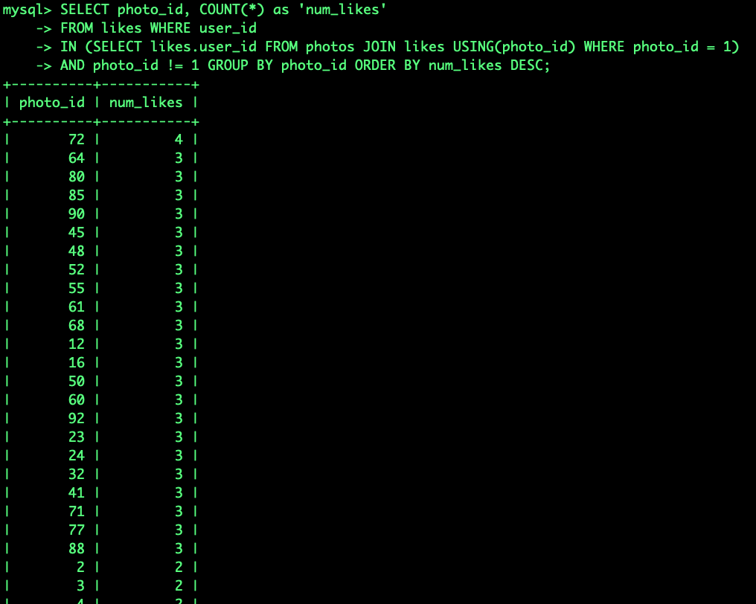
CRM (Personalized Recommendation)
Find what you will most likely to like(similar post) based on your like on certain photo.
Rank list of photos which other people also liked the same photo
Use photo 1 for example:
SELECT photo_id, COUNT(*) as 'num_likes'
FROM likes WHERE user_id
IN (SELECT likes.user_id FROM photos JOIN likes USING(photo_id) WHERE photo_id = 1)
AND photo_id != 1 GROUP BY photo_id ORDER BY num_likes DESC;

Slide 41
Create Procedure for Recommendation
DELIMITER //
CREATE PROCEDURE get_recom(in PhotoID INT)
BEGIN
SELECT photo_id, COUNT(*) as 'num_likes'
FROM likes WHERE user_id IN
(SELECT likes.user_id FROM photos JOIN likes USING(photo_id) WHERE photo_id = PhotoID)
AND photo_id != PhotoID
GROUP BY photo_id
ORDER BY num_likes DESC;
END //
DELIMITER ;
CALL get_recom(1);
CALL get_recom(2);
….

Slide 42
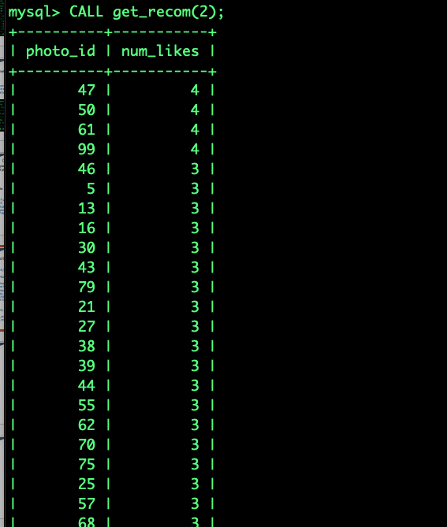

Slide 43
QUESTIONS

